Slide 1

Web Application
Security
Introduction to C programming

Slide 2
Introduction
Family History:
C: developed in AT&T Bell labs between 1968 and 1973 (to aid development of Unix OS)
C++: development started 1979 in Bell Labs
Added OO to C (so is roughly a superset of C)
Java: development started from 1991 by Sun Microsystems
“Cleaned up” C++ for programmers, OO, also “WORA” (“write once, run anywhere”)
Others in the family: C#, JavaScript, Objective-C, Perl, PHP, Python (and more…)
Basic language constructs typically borrow heavily from C
More advanced language features can differ radically

Slide 3
C Overview
C is a structured/procedural programming language
No OO!
Compiles to machine code (no VM)
Code can execute quickly due to low system overheads
Popular for “system programming” because it gives access to low-level features of hardware and the OS
Also for embedded programming
Expects the programmer to know what s/he is doing!
No garbage collection, exceptions
Memory management is the responsibility of the programmers, which can be problematic!

Slide 4
Introduction
Need to use pointers to keep track of values in memory, e.g. dynamically-allocated data structures
We talk about functions instead of methods (no OO)
Strings are simply arrays of characters, which are primitive to work with (and can be misused!)
Complex functionality like I/O, string manipulation, math etc. is handled using library functions provided with the compiler

Slide 5
Comparison of Java and C
Java | C
Object-oriented | Function-oriented
Strongly typed | More weakly typed
Layered I/O model | Byte stream I/O model
Automatic memory management | Programmer is responsible
No pointers | Pointers commonly used
Parameters passed by value or by reference | By value parameters only
Exceptions | OS “signals”
Arrays “clever”, e.g. can get length and detect attempt to access index out of bounds | No help, you’re on your own
String is a complex type (Class) | Null-terminated array of characters

Slide 6
Simple Java Program: “Hello World”
public class HelloWorld
{
public static void main(String args[])
{
System.out.println("Hello world\n");
}
}

Slide 7
Simple C Program: “Hello world”
*
#include <stdio.h> /* preprocessor directive */
int main(int argc, char *argv[]) /* main function */
{
printf("Hello world\n"); /* output to screen */
return 0; /* program result, returned to OS */
}

Slide 8
Simple C Program
Preprocessor: a program run before the compiler itself
#include <stdio.h>: get the contents of the file called “stdio.h” and replace the #include line in the source code with those contents
Keeps code for library functions separate from calling code
int main(int argc, char *argv[]): main function signature. int argc contains the number of command-line arguments (if any), char* argv[] is a character array (a “C string”) containing the values of the arguments (if any). Note that C programs should return an integer
0 = ok
Non-0 = problem occurred in program

Slide 9
Simple C Program
printf("Hello world\n") : printf = “print formatted”, output string to screen
return 0: return value of program. Given to OS which can use it for further processing, e.g in a batch file.
0 = ok
Non-0 = problem occurred in program

Slide 10
C language keywords
Standard ANSI C contains the following keywords:
auto break case char const continue default do double else enum extern | float for goto if int long register return short signed sizeof | static struct switch typedef union unsigned void volatile while

Slide 11
C Data Types
*
C requires variables to be declared before use
int age=20;
Basic types: char, int, float, double
Additional integer specifiers: signed, unsigned, short, long
The specifiers can be added to the basic types to affect the specific type of the variable
Examples:
unsigned int age=20;
short int age=20;
signed long salaryChange=-9000;
No boolean, no byte data types (handled with char or integer types instead)
Size of variables of given types are not standardized (unlike in Java). Use sizeof() function to determine memory usage

Slide 12
Variable Declaration
Examples:
char c=‘A’;
char c=65;
int age=20;
float pi=3.14159f;
double pi=3.14159;
char *name= “Adam”;
Variable scopes in single source code files are generally consistent with Java

Slide 13
Constant declaration
*
C programs use the #define preprocessor directive to create constants
#define PI 3.14159
Note:
No assignment operator (“=“), and no ; at the end of the line, this is not a C language statement
When the program is being compiled the compiler finds any occurrence of the string PI in the source code and replaces it with the second string (3.14159)

Slide 14
Selection Statements
*
Same as in Java
if
if..else
switch
These work the same as they do in Java (switch only works with integer types however, e.g. int, char etc.)

Slide 15
Looping Statements
*
Again, the same as in Java
while
do..while
for
Only the “classic” for loop is available
e.g. for (int i=0; i<10; i++)

Slide 16
Output
C uses “streams” for input and output
A stream is an input or output channel that exists between a program and its environment, e.g. the console
Three standard streams available to C programs:
standard input (stdin)
standard output (stdout)
standard error (stderr)
printf() writes bytes to the stdout stream, which causes them to be displayed on the screen

Slide 17
Output
printf() is given a string telling it what to display, and how it should be formatted
printf(“Hello world\n”);
If variable or constant values are to be shown, “format specifiers” are given
int age=20;
printf(“Your age is %d\n”, age);

Slide 18
Output
There are a number of specifiers, used to output different data types, e.g.:
%i or %d – integer
%c – char
%f – float or double
%s – string
Example:
char *name=“Adam”;
int age=20;
float height=5.8f;
printf(“Name:%s Age:%i Height:%f\n”,name,age,height);

Slide 19
Input
*
There are a number of different functions that can be used to read in data from the user, we will look at scanf now (scan formatted)
scanf() needs to be given a preallocated space in memory where the data entered by the user will be stored
It also needs to be told what the format (type) of the data
Example:
int age=0; /* allocate space to hold the age */
printf(“Enter your age:”);
scanf(“%d”,&age); /* The & before age is important! */

Slide 20
Input
scanf(“%d”,&age);
The “%d” format specifier tells the program to treat the data it receives from the keyboard as an integer value
&age tells the program to store the value in the space allocated at the address in memory where the variable called age is held (age is a buffer)
Don’t leave out the &, that won’t work!
Example:
char c=‘\0’; /* the null value */
float height=5.8f;
scanf(“%c”, &c);
scanf(“%f”,&height);
printf(“Character:%c Height:%f\n”,c,height);

Slide 21
Pointers
A pointer is a variable in a C program that holds an address in memory of something else
Pointers are used to track the locations in memory of values that the program needs to find later on
A pointer is a separate variable from the variable it “points to”, we have to declare both
Example: non-pointer variable access:
int age=20; /* identifier used to access value */
printf("Your age is %d\n", age);

Slide 22
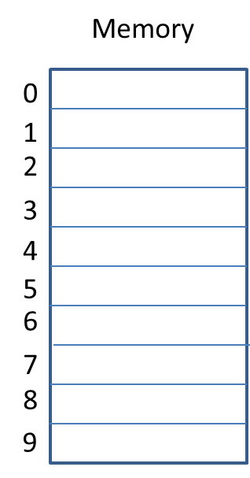
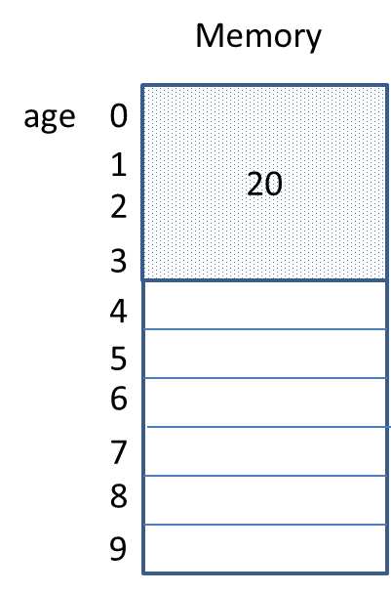
Pointers
Before variable
declaration
int age=20;
Integer takes four bytes
to store in memory

Slide 23
Pointers
Example: value access via a pointer
int age=20;
int* p=&age;
printf(“Your age is %d\n”, *p);
In the pointer declaration (int* p) the * means “this is a pointer variable which will hold the address of an integer value”
The & operator gives us the address in memory of the variable it is used with (age)
To get the value at the address held in the pointer, use the * operator again (*p)
This is called “dereferencing” the pointer
If you leave out the * in *p (i.e. if you just say p) you will see the address itself

Slide 24
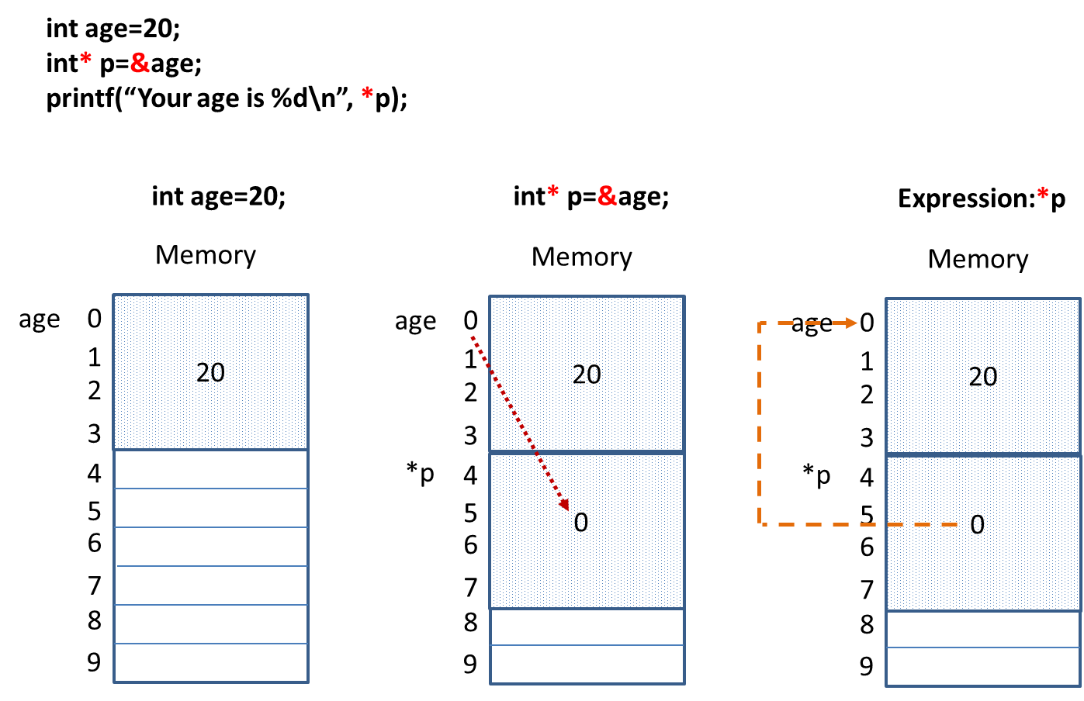
Pointers

Slide 25
Pointers
*
When can we use pointers in C?
To access data held in other variables
To access information stored in arrays (and strings)
To create dynamic data structures
To pass variable parameters to functions

Slide 26
Memory Management
Unlike Java, C does not provide automatic memory management for us, i.e. garbage collection
It is up to the programmer to manage memory correctly!
This has been (and still is) a great cause of problems in programs written in C and C++ (memory leaks!)
We can dynamically allocate memory at run-time using the malloc() function, and “deallocate” it using the free() function when the program no longer needs it
Common problem: forgetting to use free()

Slide 27
Memory Management
Example:
int* p = (int*) malloc( sizeof(int) );
*p=99;
printf("The integer value is %d\n", *p);
free(p); /* Important!!!!! */

Slide 28
Memory Management
Notes:
int* p = (int*) malloc( sizeof(int) );
Allocate enough space to store an integer value
malloc returns a pointer to the location of the value
We must cast the pointer into the correct type for the variable that’s going to store it (int* in this case)
Store the pointer pointing to the value in a pointer variable (*p) so we can find it later when necessary
*p=99;
Dereference the pointer using * to store the value 99 in the integer it points to

Slide 29
Memory Management
Notes:
Expression: *p (in the printf statement)
Go to the memory location specified in the pointer p, and return the value at that location
free(p);
Deallocate the memory pointed to by p, so the system can use it for something else later if necessary
This does not destroy the pointer variable p
We must not try to dereference the pointer p after we have used free() !!!!!

Slide 30
Memory Management
*
Programs have two general areas of memory available to them:
Stack:
Used by the program to hold information about functions that are running, their addresses in memory, and parameter values that are being passed between them
Grows and shrinks are functions call each other, and return
Variables that are declared in a program are held on the stack, e.g. the pointer p
Heap:
Area of memory set aside to hold dynamically allocated data structures, e.g. the integer created using malloc()

Slide 31
Arrays
Example:
int a[5] = { 1,2,3,4,5 }; /* initialization list */
for (int i=0; i<5; i++)
printf("a[%i]=%d\n",i,a[i]);
Output: a[0]=1
a[1]=2
a[2]=3
a[3]=4
a[4]=5

Slide 32
Arrays
Notes:
Arrays in C are fixed in size, they cannot grow or shrink after they have been declared
int a[5]; creates a five element array, uninitialized(!) and containing “random” values (not good!)
Providing an initialized list means we can leave out the size of the array on declaration, i.e. int a[] = { 1,2,3,4,5 }; gives us a five element array
An index into an array in C is simply an offset from the address of the first element in the array
We can “run off the end” of the array into memory that’s not allocated to it! No error messages!

Slide 33
Arrays
*
Example: invalid array indexing in C
int a[5] = { 1,2,3,4,5 };
for (int i=0; i<10; i++)
printf("a[%i]=%d\n",i,a[i]);
Output: a[0]=1
a[1]=2
a[2]=3
a[3]=4
a[4]=5
a[5]=5
a[6]=4200896
a[7]=2130567168
a[8]=0
a[9]=0

Slide 34
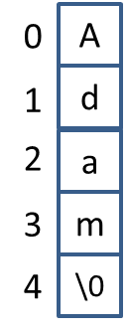
C Strings
Strings in C are simply arrays of characters
Example: declaring a string in C (a C string):
char name[]=“Adam”;
C strings must always be null-terminated
The \0 shown in the image on the right is the null character ( character 0 from the ASCII character set)
The string-handling functions provided in C all look for the null character to determine when they have reached the end of a string
If it’s not there, these functions will run off the end of the string text into memory that may be uninitialized, or allocated to other things!

Slide 35
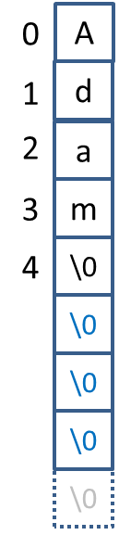
C Strings
*
If we provide more space for a C string than the text of the string required then the remainder will be padded with \0’s for us
Example:
char name[100]=“Adam”;

Slide 36
C Strings
The string.h library gives us functions for manipulating and inspecting C strings, e.g.:
strlen: return the length of a string
strcpy: copy one string into another
strcat: copy one string to the end of another (concatenate)
strcmp: compare two strings
Remember, all these functions require null-terminated C strings!
We must provide enough memory to hold the results of these operations, or we can have memory problems!

Slide 37
C Strings
Example: strlen()
char name[]="Adam";
printf("Your name is %s\n",name);
printf("%d\n", strlen(name));
Note: the length of the string does not include the null character terminating it
Output: Your name is Adam
4

Slide 38
C Strings
Example: strcpy()
char name[]="Adam";
char name2[10];
strcpy(name2,name);
printf("Second name is %s\n",name2);
Note: name2 must be big enough to accept the contents of name, including the null terminating character!
Output: Second name is Adam

Slide 39
C Strings
*
Example: strcat()
char name[]="Adam";
char name2[10]="Bill";
strcat(name2,name);
printf("Second name is %s\n",name2);
Note: name2 must be big enough to accept the contents of name, including the null terminating character!
Output: Second name is BillAdam

Slide 40
C Strings
Example: strcmp()
strcmp returns:
Zero if the two strings are the same
A negative number if string1 is less than string2
A positive number if string1 is greater than string2

Slide 41
C Strings
Example: strcmp()
char name[]="Adam";
char name2[]="Adam";
char name3[]="Bill";
printf("Same: %d\n", strcmp(name,name2));
printf("Different: %d\n", strcmp(name2,name3));
if (strcmp(name,name2)==0)
printf("name and name2 are the same\n");
else
printf("name and name2 are different\n");
Output: Same: 0
Different: -1
name and name2 are the same

Slide 42
C Strings
*
If a string is not properly terminated with a null character these functions will keep going through the memory following the string until they find a byte with a 0 value in it (“buffer overrun”)
To help avoid these sorts of problems the string.h library gives alternate versions of these functions that allow us to specify a maximum number of characters to process, e.g.:
strncpy(name2,name,10);
strncmp(name2,name,10)

Slide 43
C Functions
A function in C is analogous to a method in Java
Example:
void sayHello(void)
{
printf("Hello\n");
}
Functions are invoked as you would expect, the name is given in the calling code, e.g.
sayHello();

Slide 44
C Functions
*
We can pass parameter values to functions when they are invoked, and return results
Example:
int ageNextBirthday(int x)
{
return ++x;
}
Invocation example:
printf("Age next birthday: %d\n", ageNextBirthday(20) );

Slide 45
C Functions
Parameters can be passed to a function in two different ways in C:
Pass by Value
Pass by Reference
In pass by value a copy of the parameter value is made, and the copy is made available to the function code
The function cannot change the value of the original parameter that was provided, only the local copy (which is destroyed when the function finishes)
For pass by reference we give a pointer to the original parameter to the function. The function can dereference the pointer and so access, and possibly change, the original value of the parameter

Slide 46
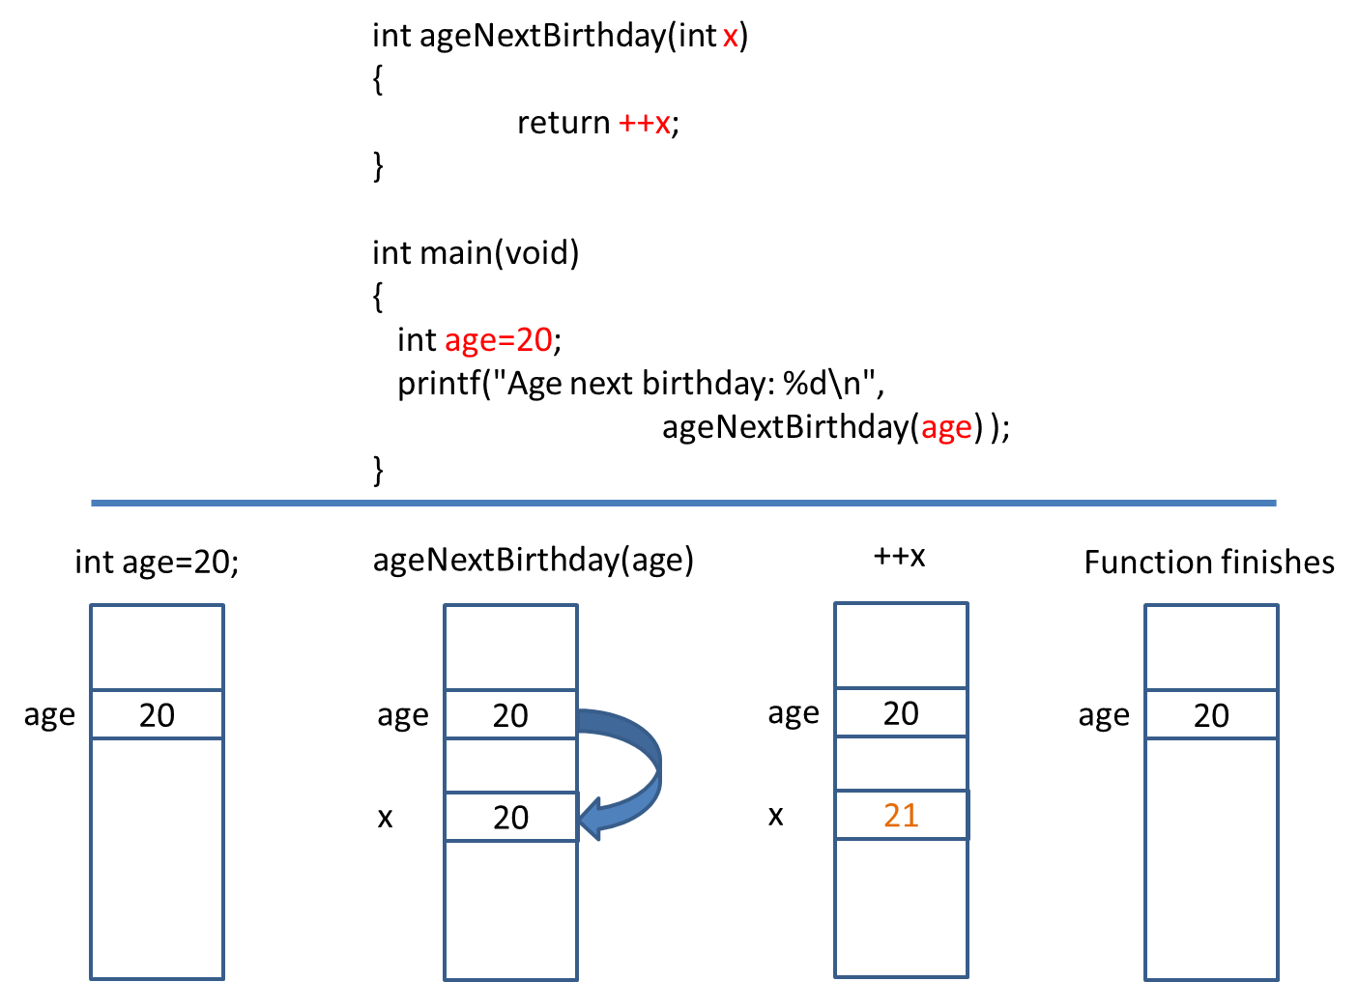
C Functions – Pass by Value

Slide 47
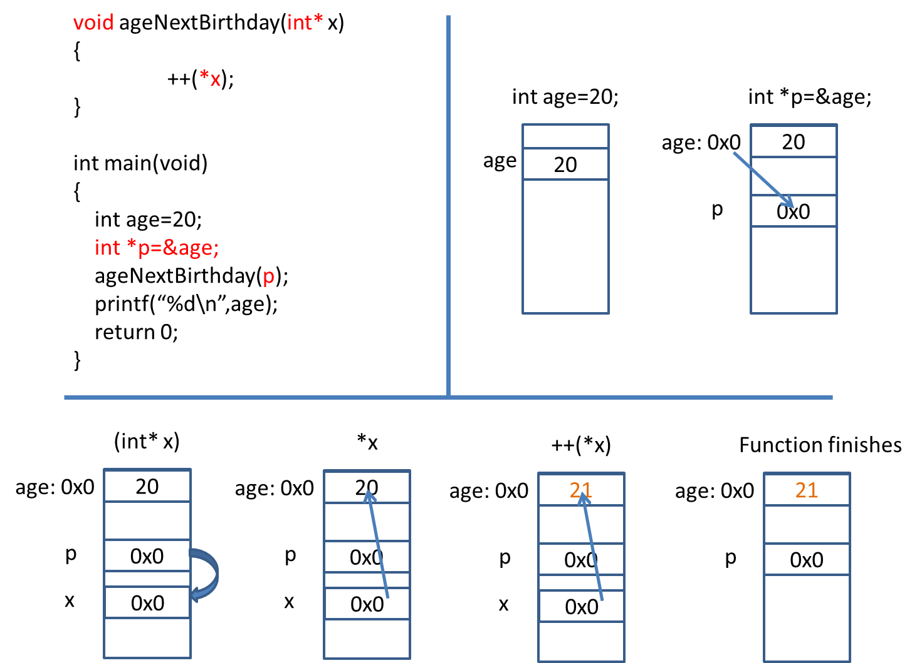
C Functions – Pass by Reference
*

Slide 48
C Functions
*
Pass by Value vs. Pass by Reference
When using pass by value code in functions cannot accidentally change the value of a passed-in parameter
Large items like arrays (and strings) are always passed by reference to avoid having to make a copy in memory of what could be large amounts of data
We can effectively return multiple results from a single function using pass by reference (pointer parameters)
Example:
void multReturn(int *x, int* y)
{
++(*x);
++(*y);
}

